Slide 1
The Norwegian NPMs dialogue with civil society
The relationship between civil society and the NPM:
A webinar for UK and Irish civil society
26th of June 2020
Notes:
Introduction to the work of the Norwegian NPM
Why the Norwegian NPM has a legislated relationship with civil society
How it works in practice and what are its limitations
How has the NPM benefited from the relationship

Slide 2
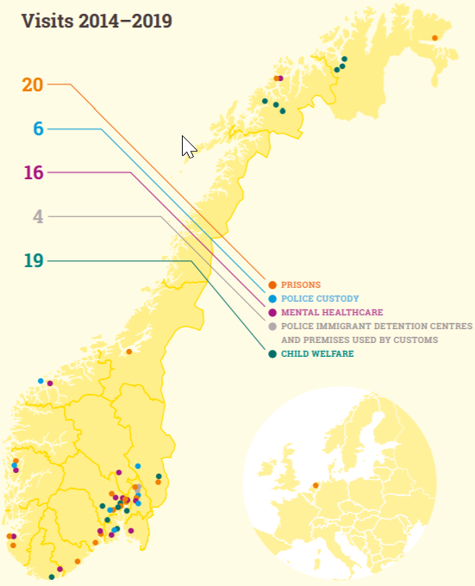
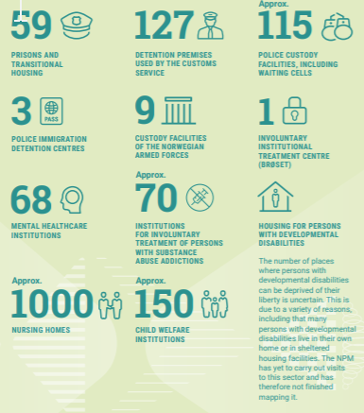
Intro: Brief overview of places and visits

Slide 3
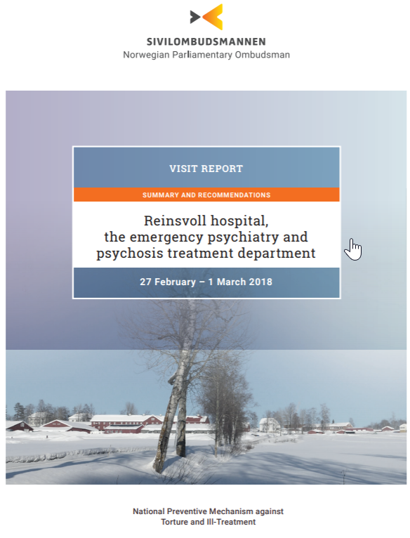
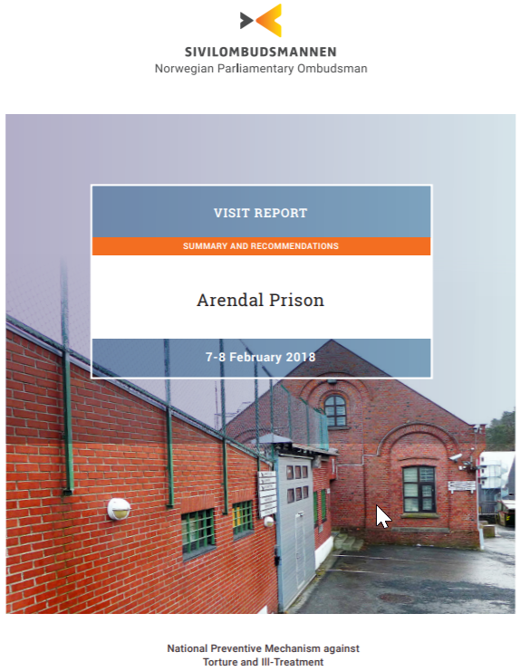
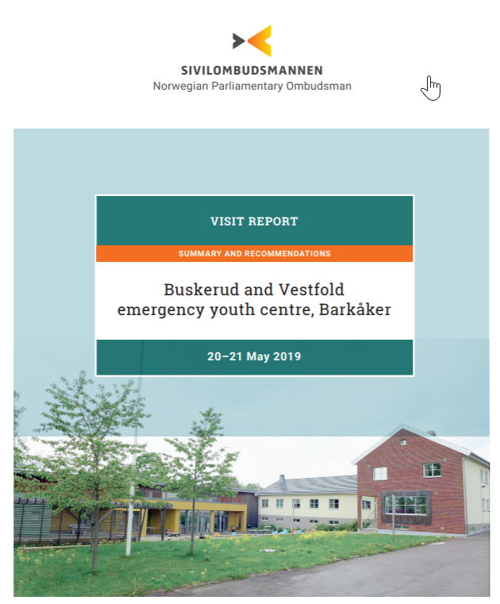
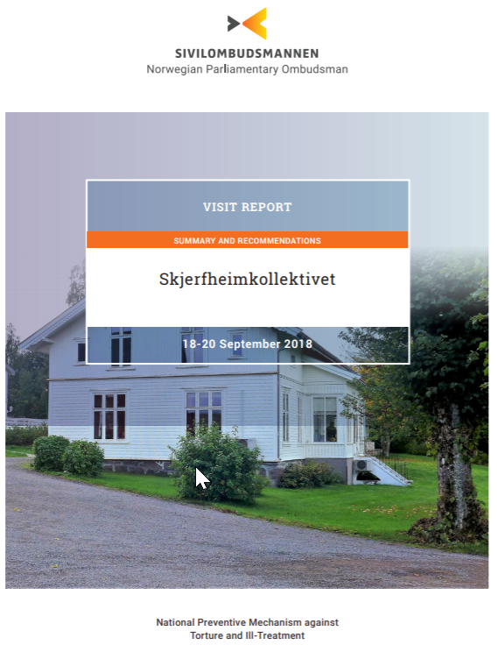
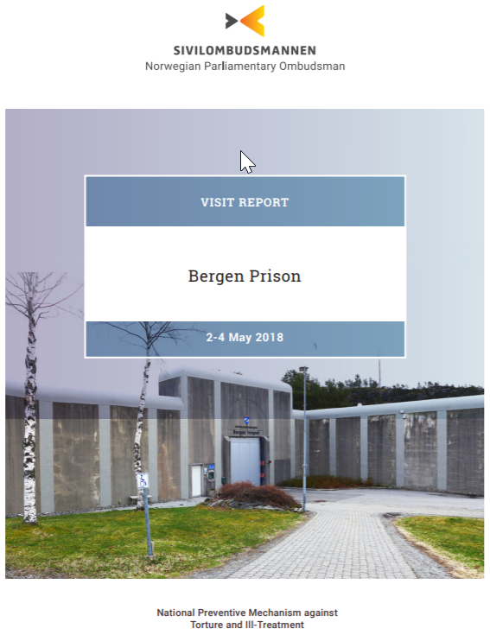
Intro: Transparency – all visit reports and thematic reports are published

Slide 4

Why the Norwegian NPM has a legislated relationship with civil society
Legal basis:
The Ombudsman act § 3 a: “the Ombudsman shall establish an advisory council for its NPM function”
Objective:
OPCAT art 18, diversity and competence:
  required capabilities and professional knowledge
  gender balance and adequate representation of ethnic and minority groups
Involving civil society to increase relevance of NPM efforts, enhance capacity + secure transparency
Format:
Flexible format: Size, members, form of dialogue

Slide 5
How it works – practice and limitations
The Equality and Anti-Discrimination Ombudsman
Ombudsman for Children
National Human Rights Institution
Bar Association, Human Rights Committee
Psychological Association, Human Rights Committee
Medical Association, Norwegian Psychiatric Association
Alliance for Carers
Juss-Buss (Free legal aid service run by law students)
Association for Persons with Development Disabilities
Association of Youth Mental Health
We Shall Overcome
Research Network on Coercion in Mental Health Care
Helsinki Committee
Amnesty International
Organization for Asylum Seekers
Organization for Children in Care
Wayback – Foundation for the Rehabilitation of prisoners
Composition: Stakeholder perspective/Knowledge perspective
15-17 members
3-4 meetings annually in full group
Targeted/smaller meetings on ad hoc/needs basis
Information sharing – “both” ways
Independence/autonomy as basis for cooperation

Slide 6
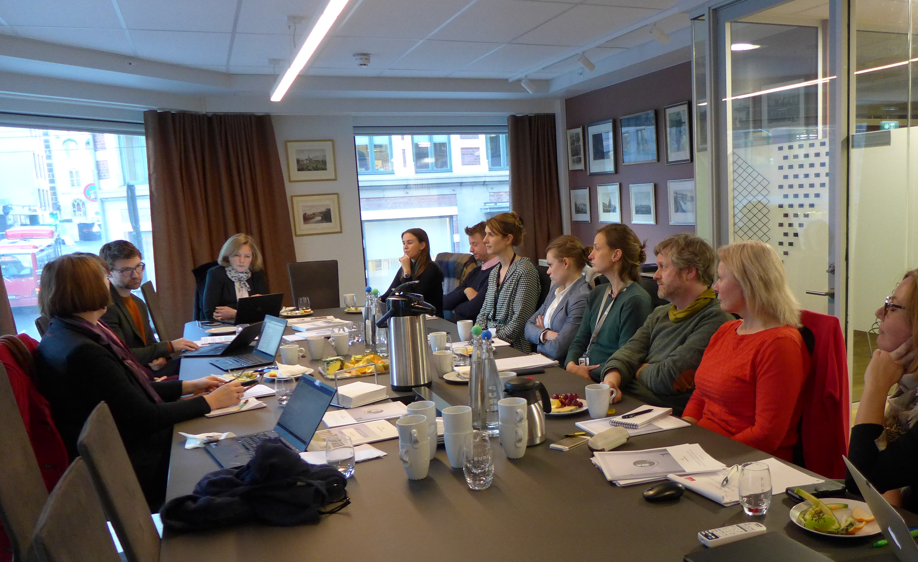
How has the NPM benefited from the relationship?
Increased competence; civil society build our expertise
Innovation, arena for testing:
  Development of methodology
  Prioritizations of sectors/areas
Cross-fertilisation
Increased impact of follow-up activities
Support
Credibility

Slide 7
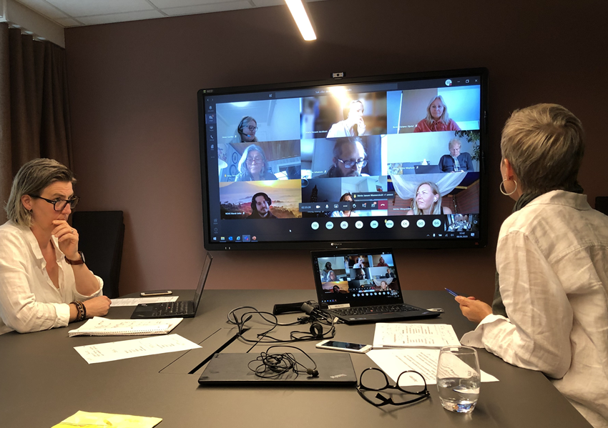
… Benefits during Covid-19 Pandemic
New risks – need for input from civil society on
  New detention areas?
  New/increased restrictions in places of detention?
  Less inspections/oversight?
Digital meetings, email, telephone, etc

